Slide 1
DATA MINING PROJECT
Mobile Price and Parameters Analysis based on Weka
Yu SU 55323707
Xinpin XU 55362327
Peiyu LI 55327269
Zhonghao YIN 55308083

Slide 2
Content
Motivation
Classification
Data preprocessing
Regression
Association rules
Prediction&conclusion
Notes:
main work of our proje

Slide 3
Motivation
Analyze the relationship between mobile phone price range and mobile phone parameters
A mobile price dataset from kaggle https://www.kaggle.com/iabhishekofficial/mobile-price-classification
Association rules
Assess the performance of different classification methods
Classification
Regression
Predication and get a conclusion
Notes:
dataset download from kaggle
and using Asso

Slide 4
2.1 Data Description
Attribute | Type | Mean | Std.deviation | min | max
battery_power | Numeric | 1.24k | 439 | 501 | 2k
blue | Boolean | 0.49 | 0.5 | 0 | 1
clock_speed | Numeric | 1.52 | 0.82 | 0.5 | 3
dual_sim | Boolean | 0.51 | 0.5 | 0 | 1
fc | Numeric | 4.31 | 4.34 | 0 | 19
four_g | Boolean | 0.52 | 0.5 | 0 | 1
int_memory | Numeric | 32 | 18.1 | 2 | 64
m_dep | Numeric | 0.5 | 0.29 | 0.1 | 1
mobile_wt | Numeric | 140 | 35.4 | 80 | 200
wifi | Boolean | 0.51 | 0.5 | 0 | 1
touch_screen | Boolean | 0.5 | 0.5 | 0 | 1
Notes:
1st of data propreces is da des
here list all of attributes in our dataset, including battery power, Has bluetooth or not, speed at which microprocessor executes instructions, one sim or dual sim support,Front Camera and primary camera pixels,Internal Memory,Mobile Depth in cm,Weight of mobile phone

Slide 5
2.1 Data Description
Attribute | Type | Mean | Std.deviation | min | max
n_cores | Numeric | 4.52 | 2.29 | 1 | 8
pc | Numeric | 9.92 | 6.06 | 0 | 20
px_height | Numeric | 645 | 444 | 0 | 1.96k
px_width | Numeric | 1.25k | 432 | 500 | 2k
ram | Numeric | 2.12k | 1.08k | 256 | 4k
sc_h | Numeric | 12.3 | 4.21 | 5 | 19
sc_w | Numeric | 5.77 | 4.36 | 0 | 18
talk_time | Numeric | 11 | 5.46 | 2 | 20
three_g | Boolean | 0.76 | 0.43 | 0 | 1
price_range | Numeric | 1.5 | 1.12 | 0 | 3
Notes:
n_cores: Number of cores of processor
Pixel Resolution Height and Width
ram: Random Access Memory in Mega Bytes
Screen Height and width of mobile in cm
longest time that a single battery charge will last when you are
the last one is the target variable with value of 0(low cost), 1(medium cost), 2(high cost) and 3(very high cost). corresponding to

Slide 6
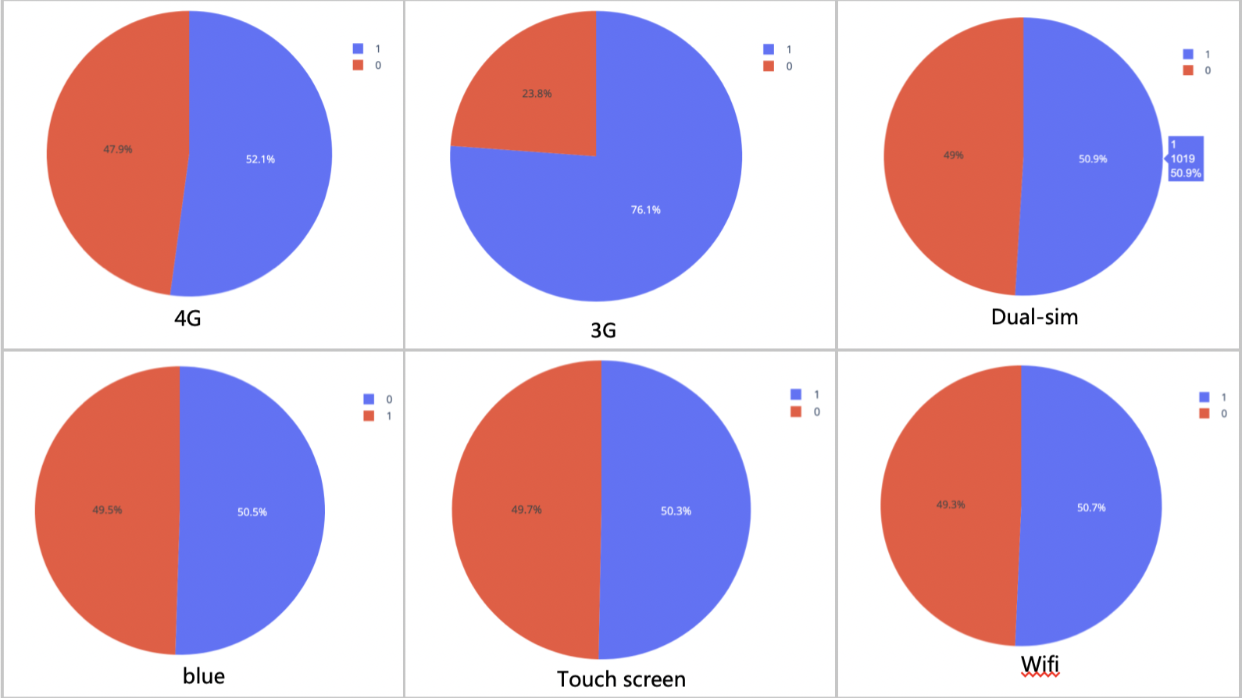
2.1 Data Description
Notes:
Pie chart shows the boolean type of

Slide 7
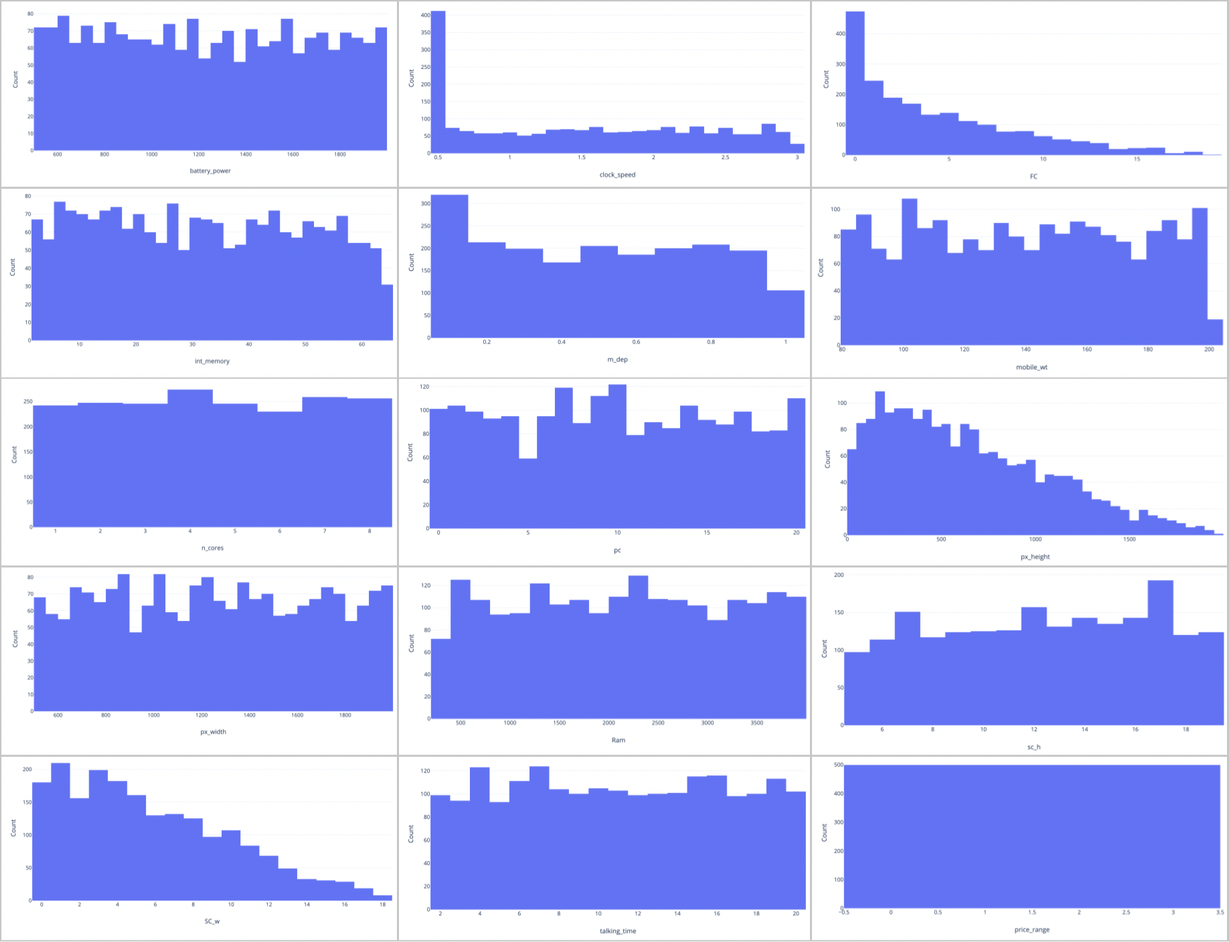
2.1 Data Description
Notes:
histogram
shows the distribution of boolean and numeric attributes respec

Slide 8
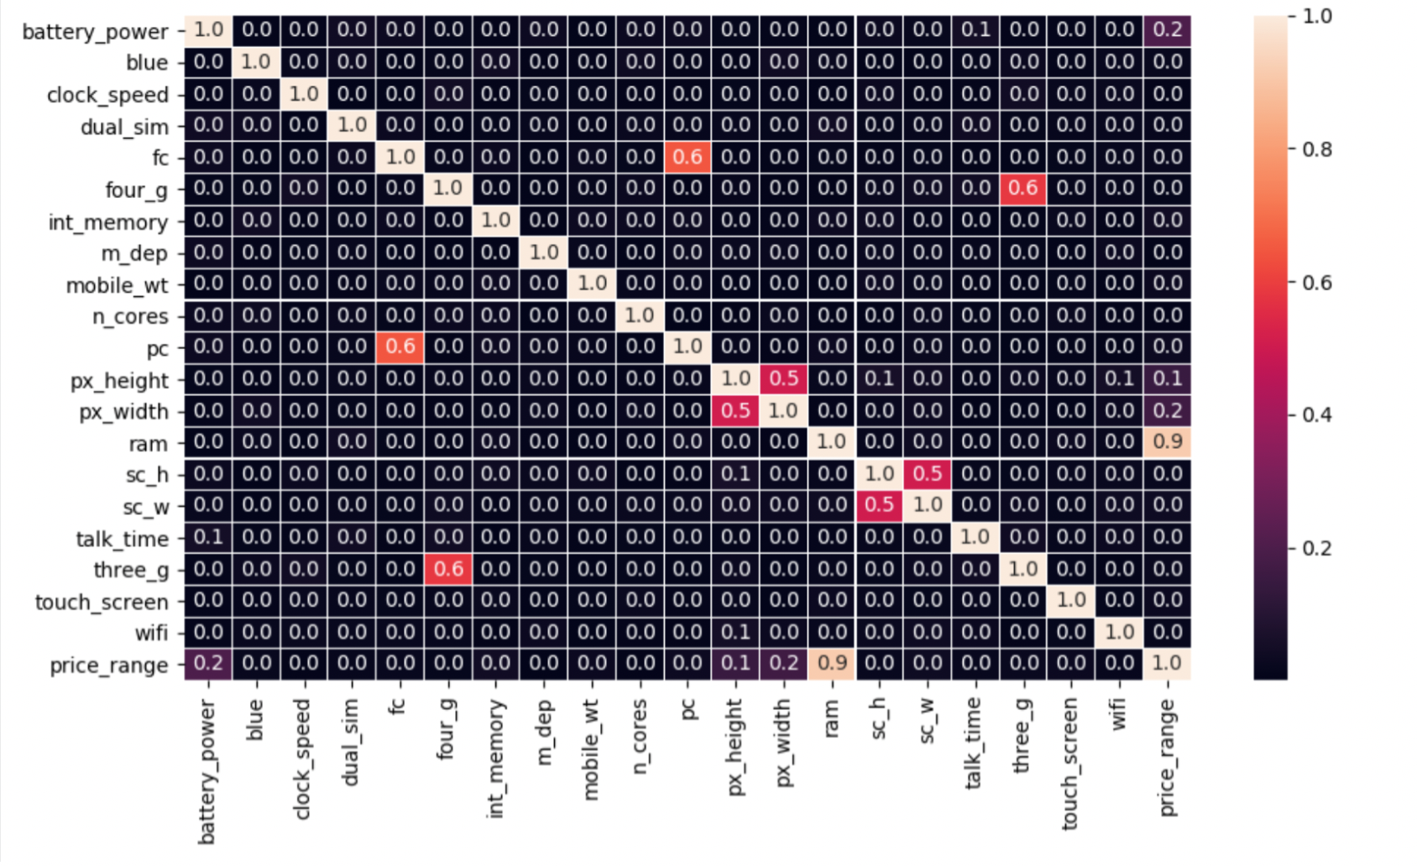
2.1 Data description
Notes:
from the heatmap which shows the relationship between each attributes(compute the correlation coefficient ), and you can see the attribute of pc and fc, four g and three g, ram and price range are correlated to each other, which means they have some relationship that we should find out.

Slide 9
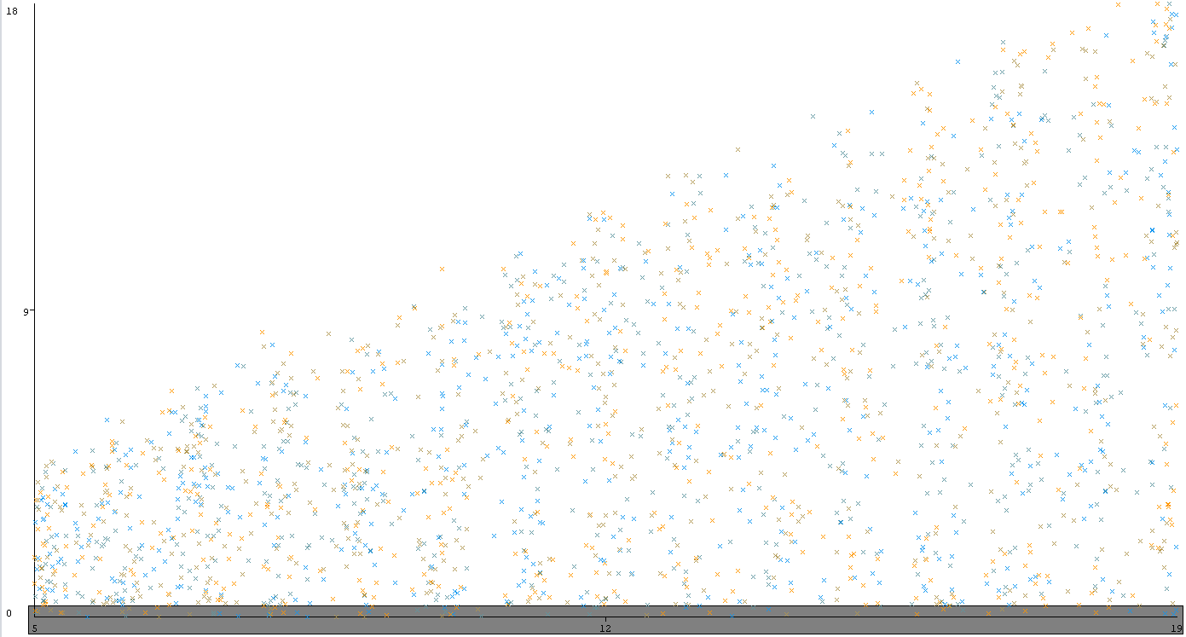
2.2 Data cleaning
add missing data(There is no missing data in our data)
delete noise instance
delete the instance whose
screen width < 1 cm.
Notes:
there are two steps. 1st step is
2 step is noise analysis
from the visualization of weka, we

Slide 10
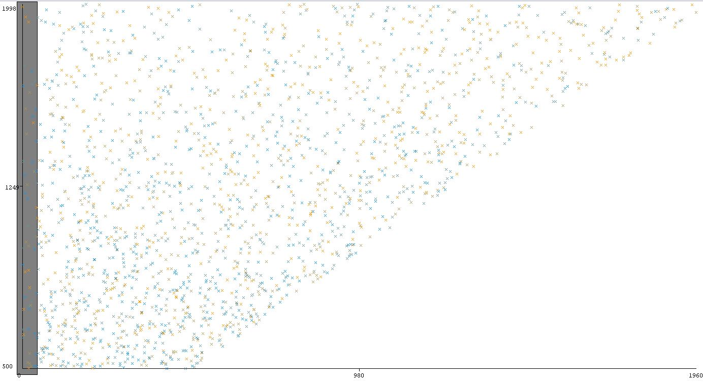
2.2 Data cleaning
delete the instance whose
resolution pixel height < 50

Slide 11
3. Association Rules
20 attributes
Finding rules among each attributes
2 approachs
Apriori
FP-Growth

Slide 12
3.1 Data preprocess
To avoid the binary attribute bias the result, because they will have higher support.
discretize each attributes to 2 bins with equal frequency
convert nominal and numeric to binary

Slide 13
3.2 Parameter Settings
Using lift as the threshold to find the really meaningful rules
Using support as the threshold to avoid the coincidence
Using convinction to evaluate the pairs

Slide 14
3.2.1 Apriori sup > 0.3, lift > 1.2
Front camera mega pixel -- Primary camera mega pixel
1. fc='(3.5-inf)'==> pc='(9.5-inf)' 2. pc='(9.5-inf)'==> fc='(3.5-inf)'
3. fc='(inf-3.5)' ==> pc='(inf-9.5)' 4. pc='(inf-9.5)'==> fc='(inf-3.5)'
Pixel Resolution Height -- Pixel Resolution Width
5. px_width='(1247.5-inf)'==> px_height='(565.5-inf)' 6. px_height='(565.5-inf)'==> px_width='(1247.5-inf)'
9. px_width='(inf-1247.5)' ==> px_height='(inf-565.5)' 10. px_height='(inf-565.5)' ==> px_width='(inf-1247.5)'
Screen Height of mobile in cm -- Screen Width of mobile in cm
7. sc_w='(inf-4.5)'==> sc_h='(inf-12.5)' 8. sc_h='(inf-12.5)’ ==> sc_w='(inf-4.5)'
13. sc_h='(12.5-inf)'==> sc_w='(4.5-inf)' 14. sc_w='(4.5-inf)'==> sc_h='(12.5-inf)'
Four g -- Three g
11. four_g=1==> three_g=1 12. three_g=1 ==> four_g=1

Slide 15
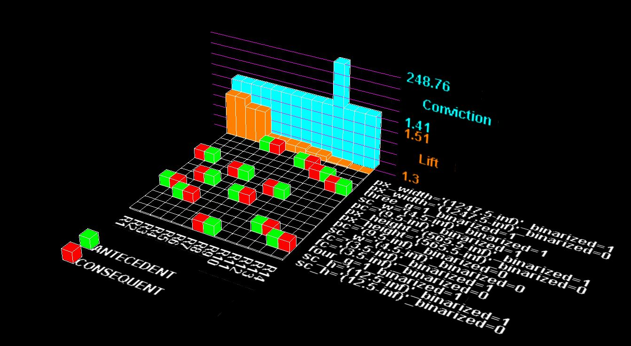
3.2.1 Apriori sup > 0.3, lift > 1.2

Slide 16
3.2.2 FP-Growth sup > 0.3, lift > 1.2
Front camera mega pixel -- Primary camera mega pixel
1. pc='(9.5-inf)'==> fc='(3.5-inf)' 2. fc='(3.5-inf)'==> pc='(9.5-inf)'
Pixel Resolution Height -- Pixel Resolution Width
3. px_width='(1247.5-inf)'==> px_height='(565.5-inf)' 4. px_height='(565.5-inf)'==> px_width='(1247.5-inf)'
Four g -- Three g
5. three_g=1 ==> four_g=1 6. four_g=1 ==> three_g=1
Screen Height of mobile in cm -- Screen Width of mobile in cm
7. sc_w='(4.5-inf) ==> sc_h='(12.5-inf)’ 8. sc_h='(12.5-inf)' ==> sc_w='(4.5-inf)'

Slide 17
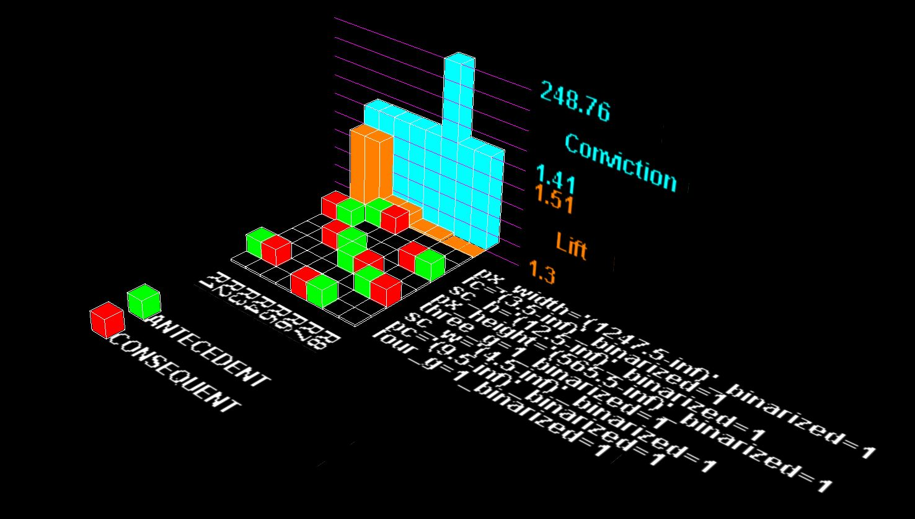
3.2.2 FP-Growth sup > 0.3, lift > 1.2

Slide 18
3.3 Comparison
Apriori:
disadvantage: slow(IO overhead, candidate number)
FP-Growth:
advantage : fast (Although our dataset is small, so it is not obvious)
disadvantage : regard one of side as the missing data(two times with different positive index)

Slide 19
3.4 Conlusion
2 types of rules
completely strong rules(reduce attributes)
Front camera mega pixel -- Primary camera mega pixel
Pixel Resolution Height -- Pixel Resolution Width
Screen Height of mobile in cm -- Screen Width of mobile in cm
one-way rules
Four g -- Three g

Slide 20
4. Classification
The data set has twenty attributes that are all numeric before discretizing and has four distinctive classes with the same weight.
Choose five classification methods in Weka
IBk
IBk judges the category of test instances by N neighbors around it.
Generally this N is judged by experience
Methods of Bayes
BayesNet : A directed acyclic graph with probabilistic annotations, each node in the graph represents a random variable
NaiveBayes : a solid mathematical foundation and stable classification efficiency.
Decision Tree
J48
Random forest

Slide 21
4.1 IBK
A smaller N value means that only training instances that are closer to the input instance will work for the prediction, but it is prone to overfitting; if the N value is large, the advantage is that the estimation error of learning can be reduced, but the disadvantage is the approximation of learning
Test results when N=1(default), N=25, N=50

Slide 22
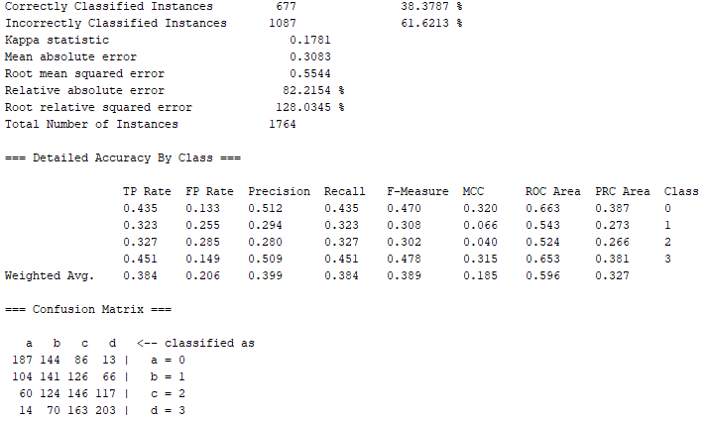

Slide 23
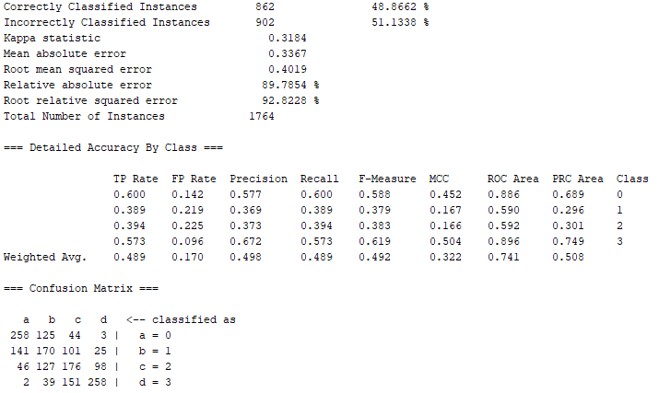

Slide 24
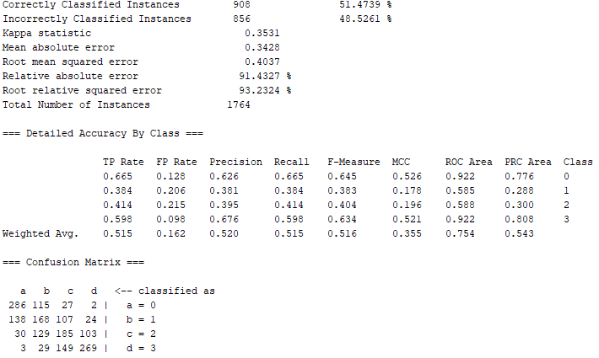

Slide 25
4.2 Methods of Bayes
BayesNet
The Bayesian network is a directed acyclic graph with probabilistic annotations.
Each node in the graph represents a random variable. If there is an arc between two nodes in the graph, it means that the two nodes correspond to each other. The random variables are probability dependent, and vice versa, the two random variables are conditionally independent

Slide 26
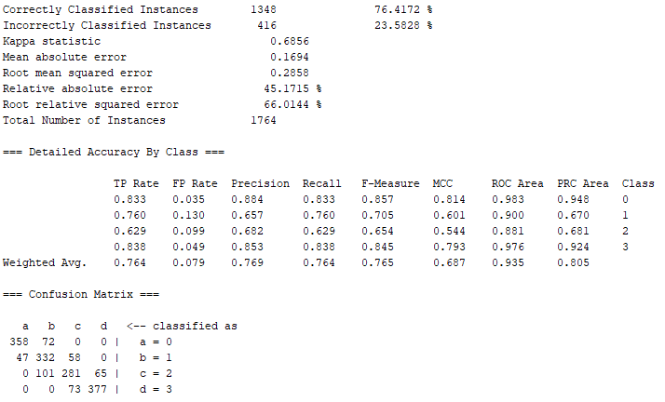

Slide 27
4.2 Methods of Bayes
NaiveBayes
The NBC model requires few parameters to estimate, is less sensitive to missing data, and the algorithm is simpler. It assumes the attributes are independent of each other
The reality is that when the number of attributes is large or the correlation between attributes is large, the performance of the classifier will be affected

Slide 28
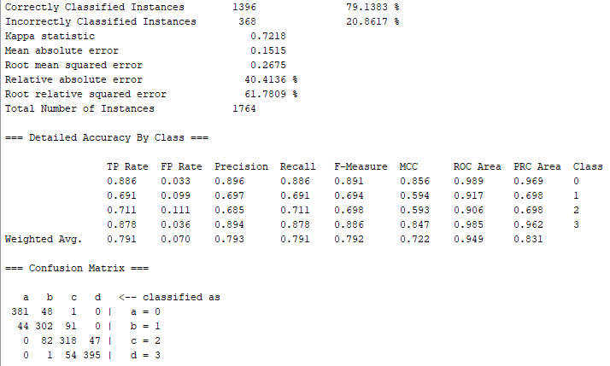

Slide 29
4.3 Decision Tree
J48
Using the information gain rate to select attributes, overcomes the inadequacy of selecting attributes with more information when selecting attributes with information gain.
Pruning during tree construction
Ability to discretize continuous attributes
The optimal model is when the mininum number of object is three

Slide 30
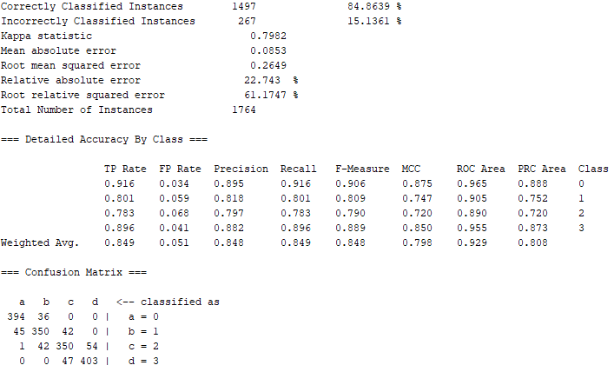

Slide 31
4.3 Decision Tree
RandomForest
Random forest is a classifier that contains multiple decision trees, and the output category is determined by the mode of the category of the individual tree output.

Slide 32
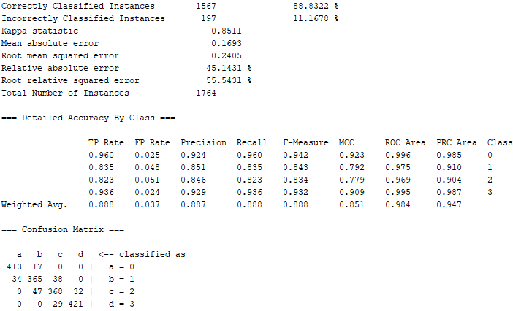

Slide 33
4.4 Classification after Attribute Selection
By using the Attribute Selection(CfsSubsetEval ) in Weka,we find the the attributes no.1(battery_power),no.12(px_height),no.14(ram),no.19 (touch_screen_binarized) are selected
The results of the classification will also be changed
In the case of different N values, the classification results of IBK have been greatly improved
In the case of different minimum number of objects of J48,and the Randomforest .The classification results of both methods improve slightly
The results of BayesNet and NaiveBayes both decrease a little

Slide 34


Results before Attribute Selection
Results after Attribute Selection
The best classification method is RandomForest

Slide 35
5. Regression
The data in our data set is discrete rather than continuous.
Choose two logistic regression methods in Weka
SimpleLogistic
symmetric
fit multinomial logistic regression problem
has a built-in attribute selection
it adds one SimpleLinearRegression model per class into the logistic regression model
Logistic
not symmetric
fit multinomial logistic regression problem
Cross-validation with 10 Folds

Slide 36
5.1 SimpleLogistic
Class 0 : 66.67 + battery_power * -0.02 + int_memory * -0.01 + mobile_wt * 0.02 + n_cores * -0.04 + px_height * -0.01+ px_width * -0.01 + ram * -0.03 + support_wifi * 0.53
Class 1 : 23.43 + battery_power * -0.01 + support_bluetooth * -0.06 + clock_speed * -0.09 + support_dual_sim * -0.07 + m_dep * 0.5 + mobile_wt * 0.01 + n_cores * -0.05 + pc * -0.01 + ram * -0.01 + sc_w * -0.03 + talk_time * -0.01 + support_three_g * -0.22 + support_wifi * 0.29
Class 2 : -25.51 + support_bluetooth * 0.08 + clock_speed * -0.08 + support_dual_sim * -0.18 + support_four_g * -0.28 + n_cores * -0.02 + ram * 0.01 + sc_h * -0.02 + support_three_g * 0.08 + has_touch_screen * -0.19 + support_wifi * -0.24
Class 3 : -95.79 + battery_power * 0.01 + int_memory * 0.03 + mobile_wt * -0.03 + n_cores * 0.05 + px_height * 0.01 + px_width * 0.01 + ram * 0.02 + sc_h * 0.07 + support_wifi * -0.24
Notes:
Class 0 focuses on whether the mobile phone support wifi.
Class 1 focuses on the mobile depth.
Touch screen has a big influence on Class2.
In conclusion, the network condition(wifi,4g,3g) is closely related to the price of mobile phone. Although the coefficients of the phone weight, the battery power and the storage space are small, they have a wide range of influence.

Slide 37
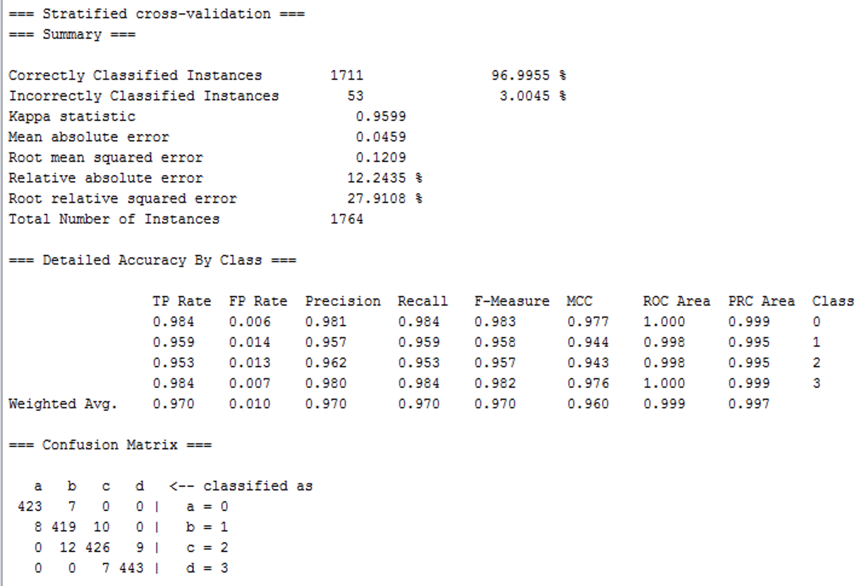

Slide 38
5.2 Logistic
Logistic give coefficients and odds ratios of all the attributes which represent some knowledge not shown by SimpleLogistic.
The odds ratio is a simple and straightforward way to tell us how much each attribute affects a certain type of prediction.

Slide 39
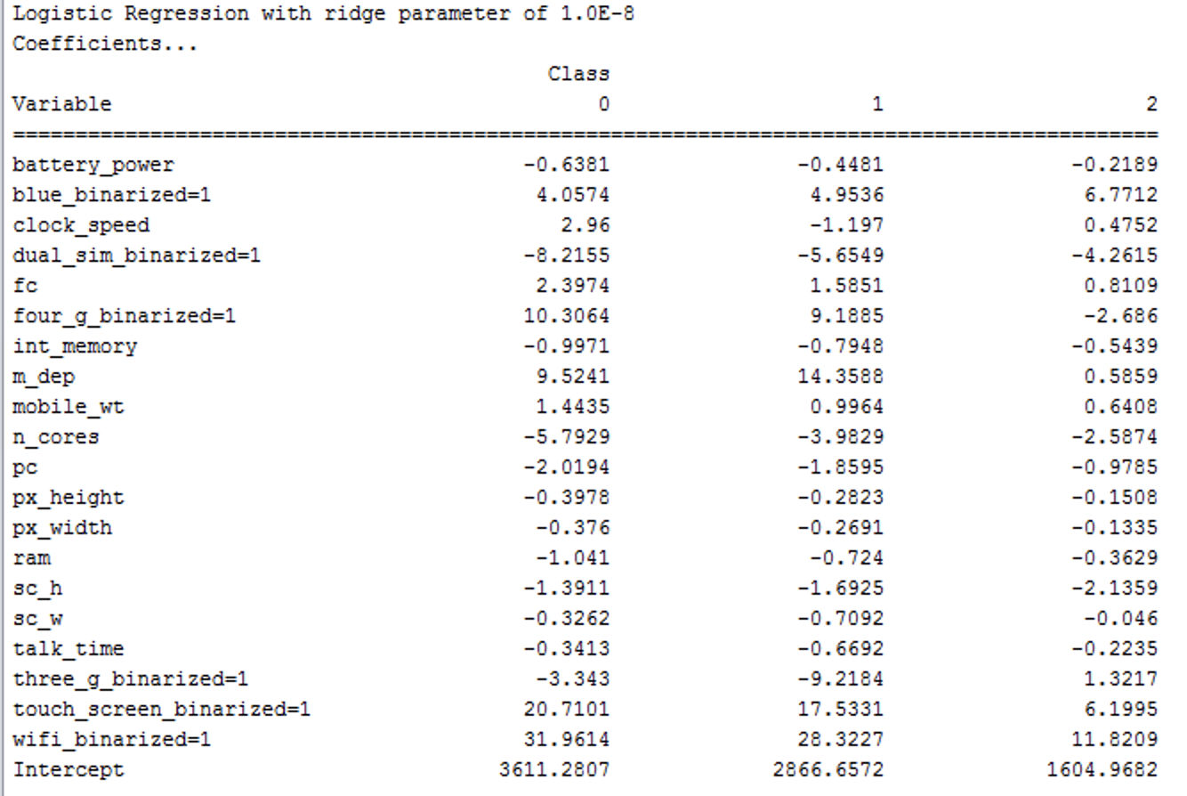
Notes:
The figure shows the relation of px_height and px_width since the coefficients and odds ratios of these two attributes are nearly the same for each class.

Slide 40
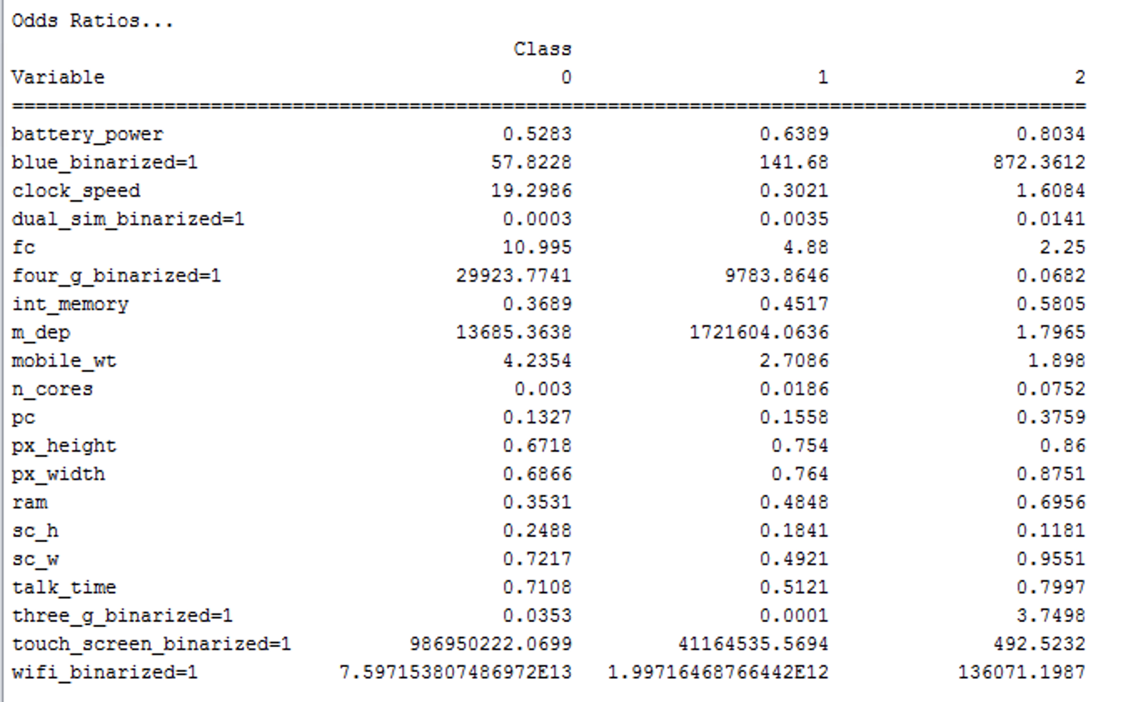
Notes:
Class 0: 4g, mobile phone depth, clock speed
Class 1: mobile phone depth, 4g
Class 2: wifi
bluetooth and touch screen has great impact on classification.
It is interesting that the number of cores of processor almost has impact for classification, and only Class 0 cares a lot about the speed at which microprocessor executes instructions.

Slide 41
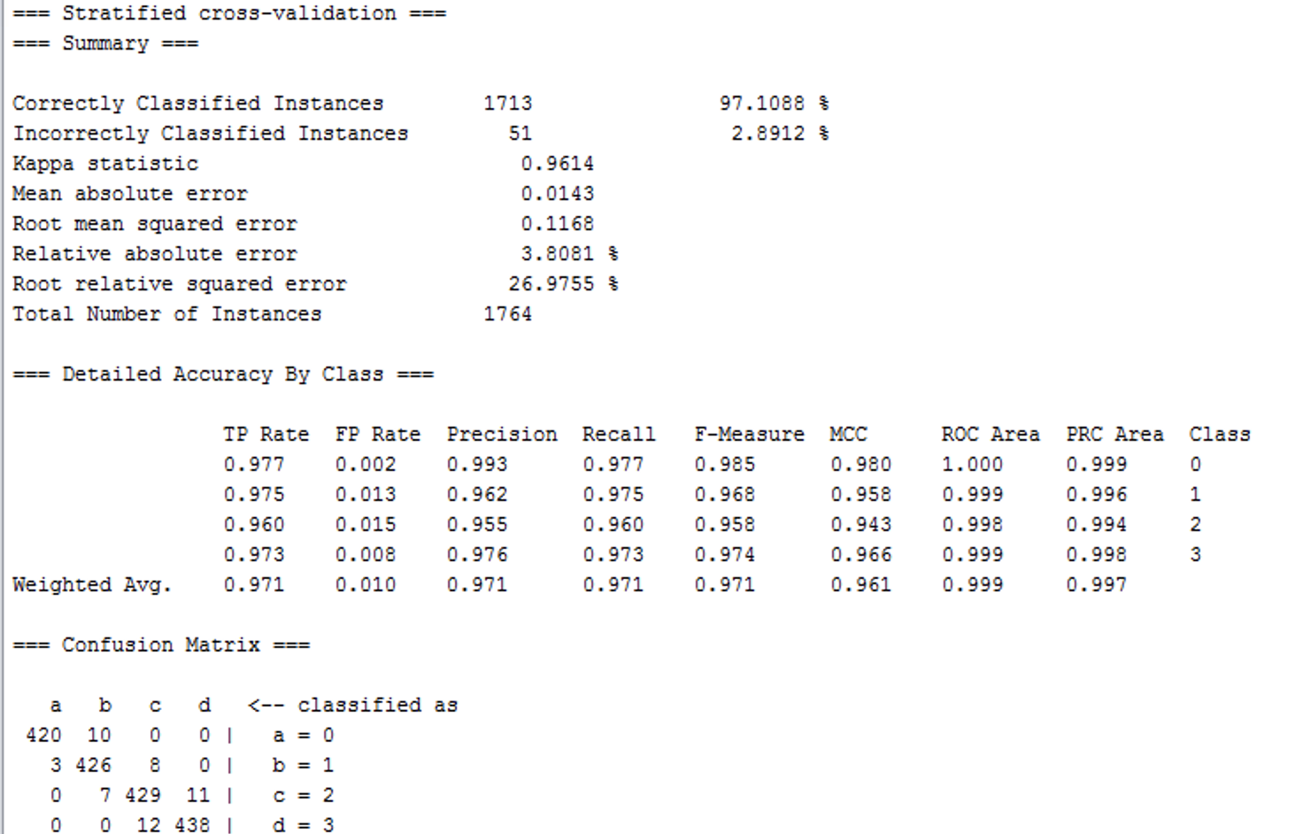

Slide 42
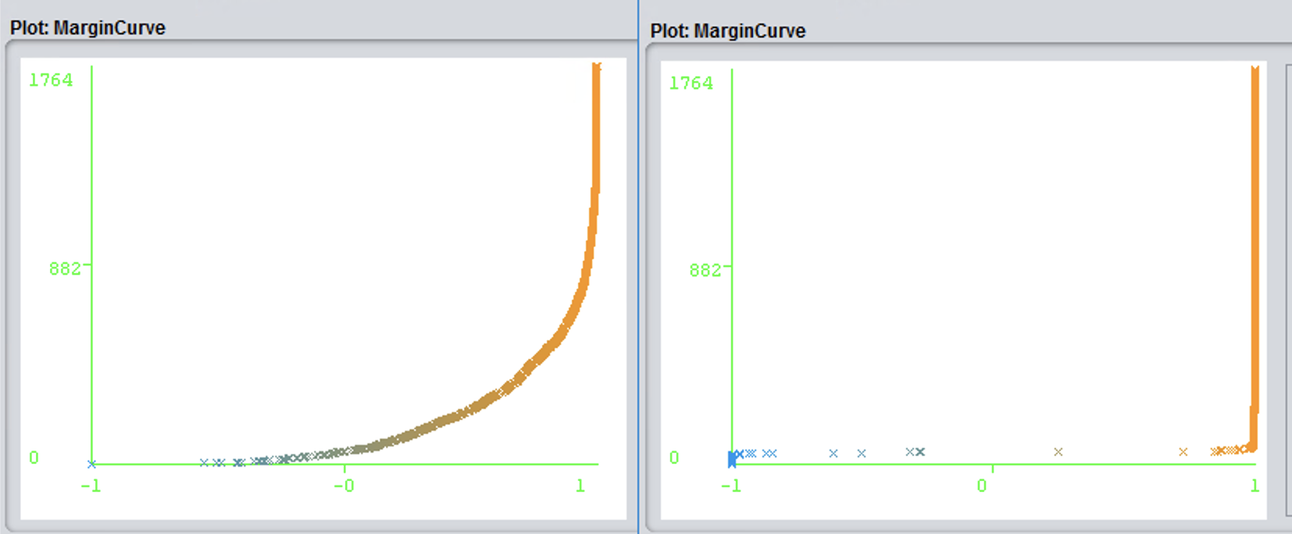
5.3 Comparison
Logistic has better performance than SimpleLogistic
The accuracy of Logistic is a bit higher.
For SimpleLogistic model, the relative absolute error and mean absolute error is higher,so the stability of it is worse than Logistic.
SimpleLogistic model has a built-in attribute selection which may let the model to ignore some special attributes, e.g. the clock speed for Class 0.
The Margin Curve of Logistic model is better than SimpleLogistic.
Notes:
Logistic has better performance than SimpleLogistic
The accuracy of Logistic is a bit higher.
For SimpleLogistic model, the relative absolute error and mean absolute error is higher,so the stability of it is worse than Logistic.
SimpleLogistic model has a built-in attribute selection which may let the model to ignore some special attributes, e.g. the clock speed for Class 0.
The Margin Curve of Logistic model is better than SimpleLogistic.

Slide 43
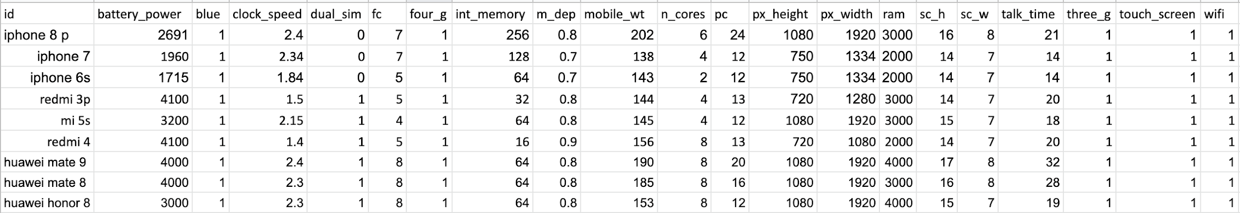
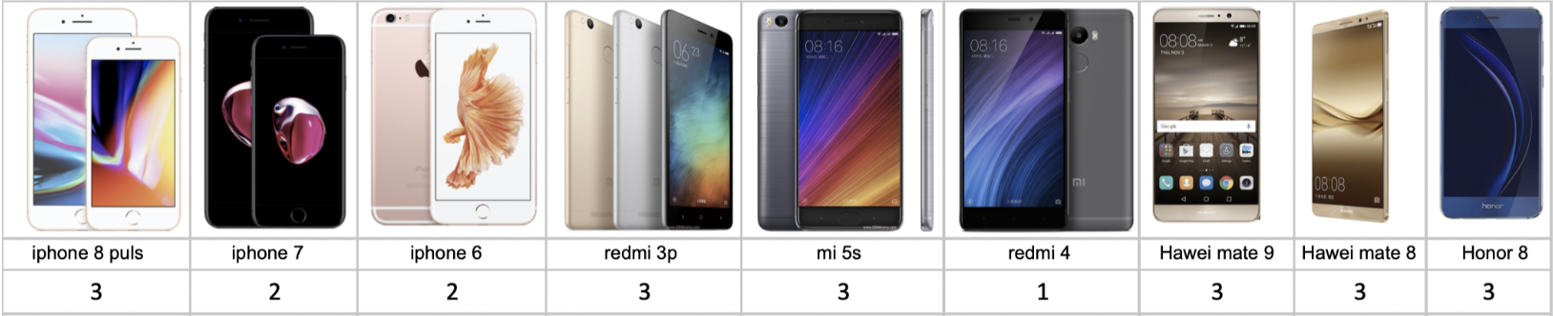
6. Prediction&Conclution
Notes:
We collect information about several mobile phones as the test set to predict the mobile price according to their performance, and using Random Forest to predict the price range of those mobile respectively.
Through the result combined with the real world, we could find the practical prediction accuracy of classification model is higher than the regression model, which just verified that the logistic regression does not fit the data with many attributes.

Slide 44
Thank You

